Slide 1
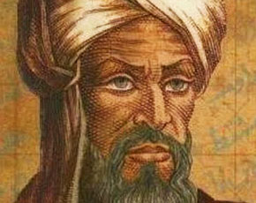
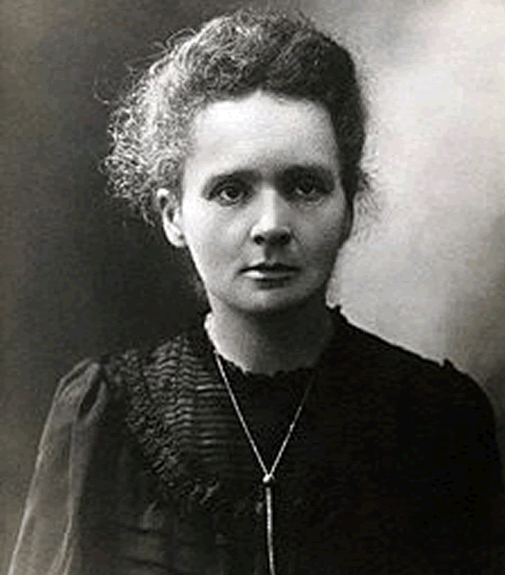
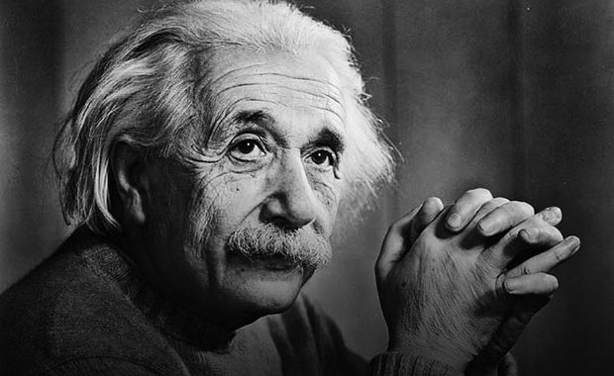
Grade Six Unit 9
Student’s Book Page 72
Famous people

Slide 2
Student’s book
page 72

Slide 3
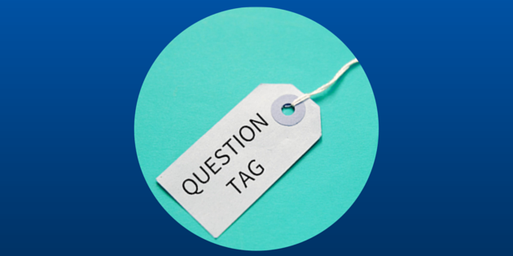

Slide 4



Slide 5
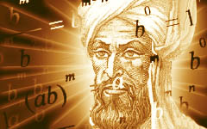
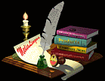
He is best known for algebra, isn’t he?
He is
isn’t he
is isn’t

Slide 6
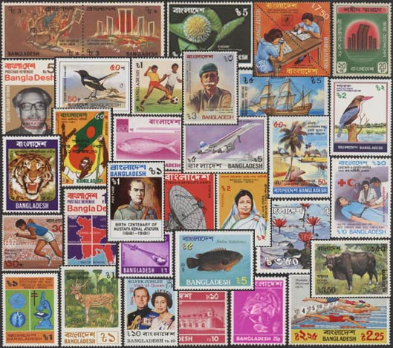
He isn’t famous for stamp collecting, is he?
He isn’t
is he
isn’t is

Slide 7
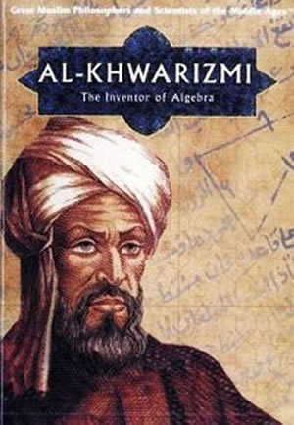
Al-Khawarizmi was born in about 780, wasn’t he?
He was
wasn’t he
was wasn’t

Slide 8
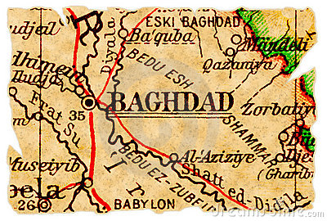
He wasn’t born in Baghdad, was he?
He wasn’t
was he
wasn’t was

Slide 9



Slide 10
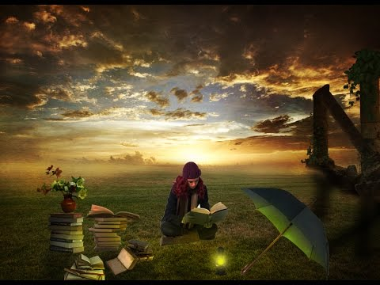
Check your answers.

Slide 11
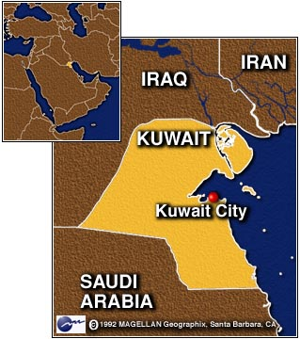
aren’t you
1- You are from Kuwait, -------------------------------------- ?

Slide 12
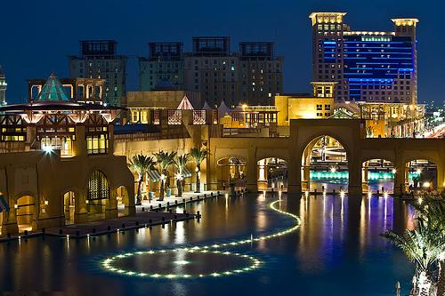
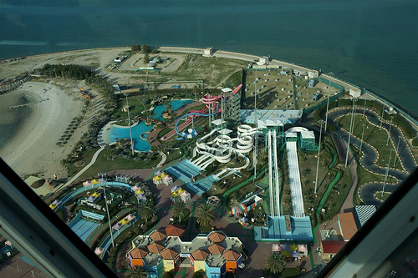
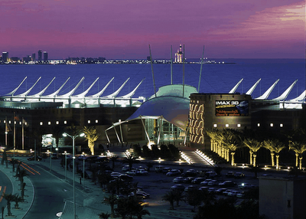
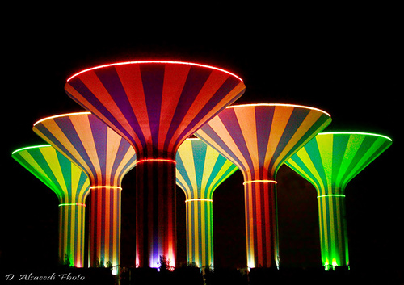
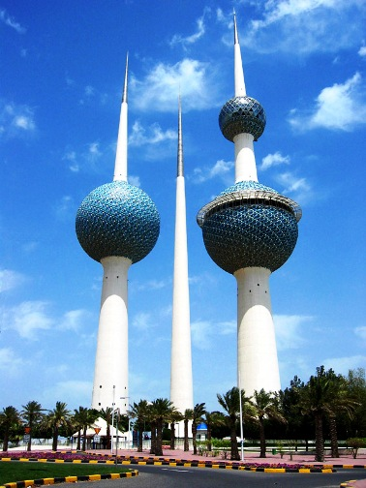
2- Kuwait is very modern, -----------------------------?
isn’t it

Slide 13
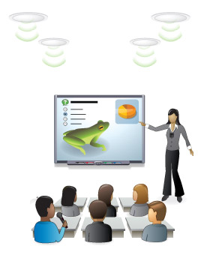
3-We aren’t studying math now, -----------------------?
are we

Slide 14
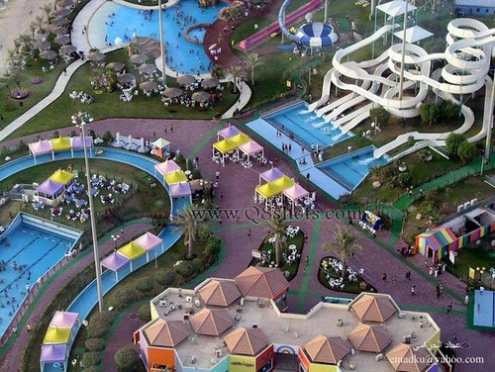
4-You weren’t at school on Friday, ----------------------------------?
were you

Slide 15
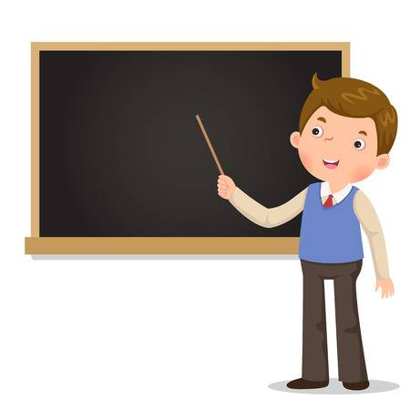
5- Our teacher wasn’t at school yesterday, ----------?
was he

Slide 16
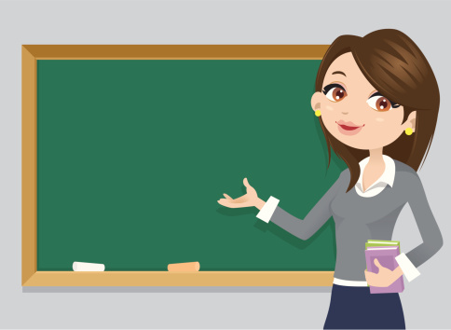
5- Our teacher wasn’t at school yesterday,--------------?
was she

Slide 17
6-There was a picture of Al-Khawarizmi on television, ------------------?
wasn’t there

Slide 18
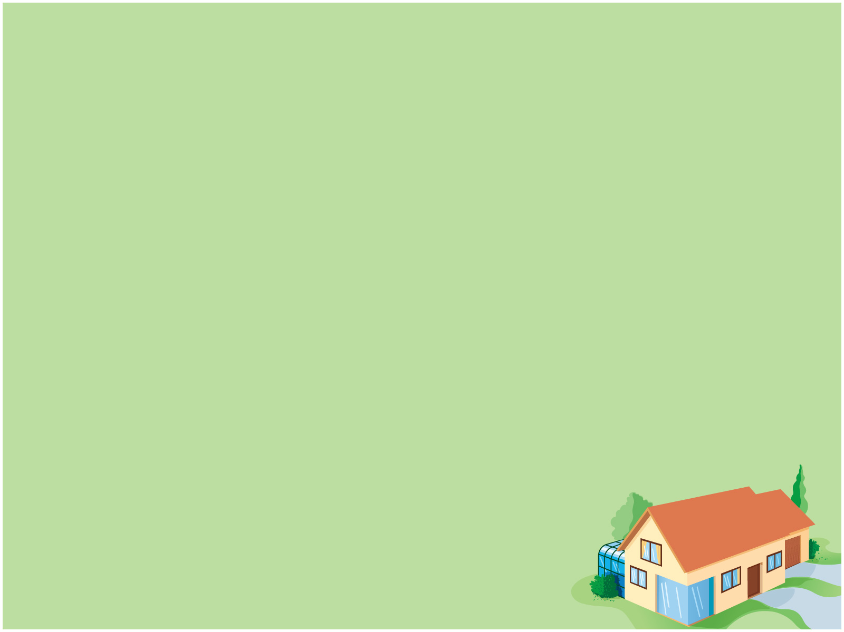



She is a doctor , isn't she?

Slide 19

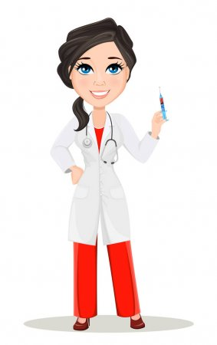
She isn’t a doctor, is she?

Slide 20


she was interested in science, wasn’t she?

Slide 21
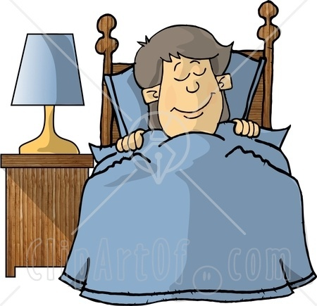
Question Tag
1
2
X
2
1
He is sleeping ,isn’t he?
He is
x
isn’t he
is isn’t

Slide 22
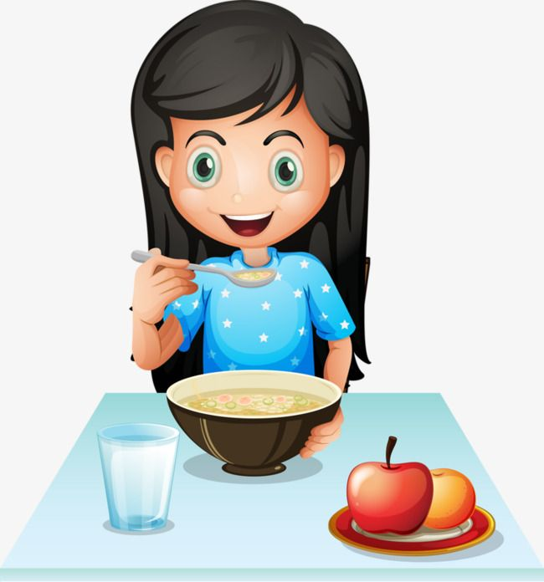
Question Tag
1
2
x
2
1
Dalia isn't eating ,is she ?
o
Dalia isn’t
isn’t she
isn’t is

Slide 23

1
2
x
2
1
wasn’t
Mona was swimming ,------ she ?
o

Slide 24
Question tag
X
2
2
1
1
isn’t she
She is a good girl,---------?
o

Slide 25
x
1
2
2
1
She is bright girl,isn’t she?
o
is she
She isn’t here now,---- ----?
aren’t you
you are studying English,------ ------?

Slide 26
1
2
x
2
1
can’t she
Dana can do Karate,------ ------?
o
won’t he
Ali will visit us today,-------- ----?
will he
Ali won’t stay home ,------- -----?

Slide 27

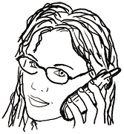

Work with a friend. Make sentences with these verbs, like the examples.
My grandfather was ill last week.
Al-Khawarizmi lived in Baghdad.

Slide 29
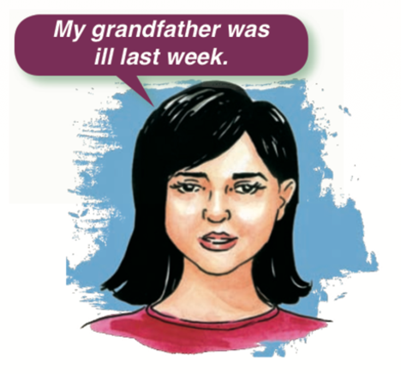
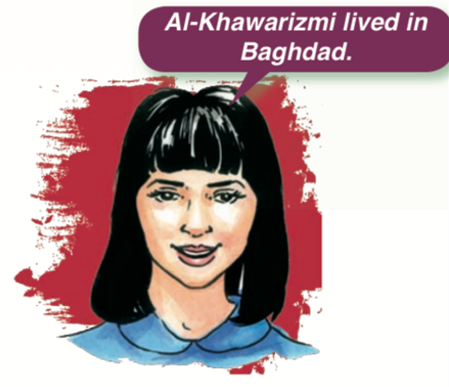
He moved the chair carefully.
Jassim wanted to buy an iPhone.
We came to school early.
I did my homework.
My mother made delicious cakes.

Slide 30
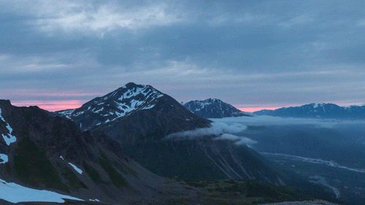
Read your sentences.

Slide 31

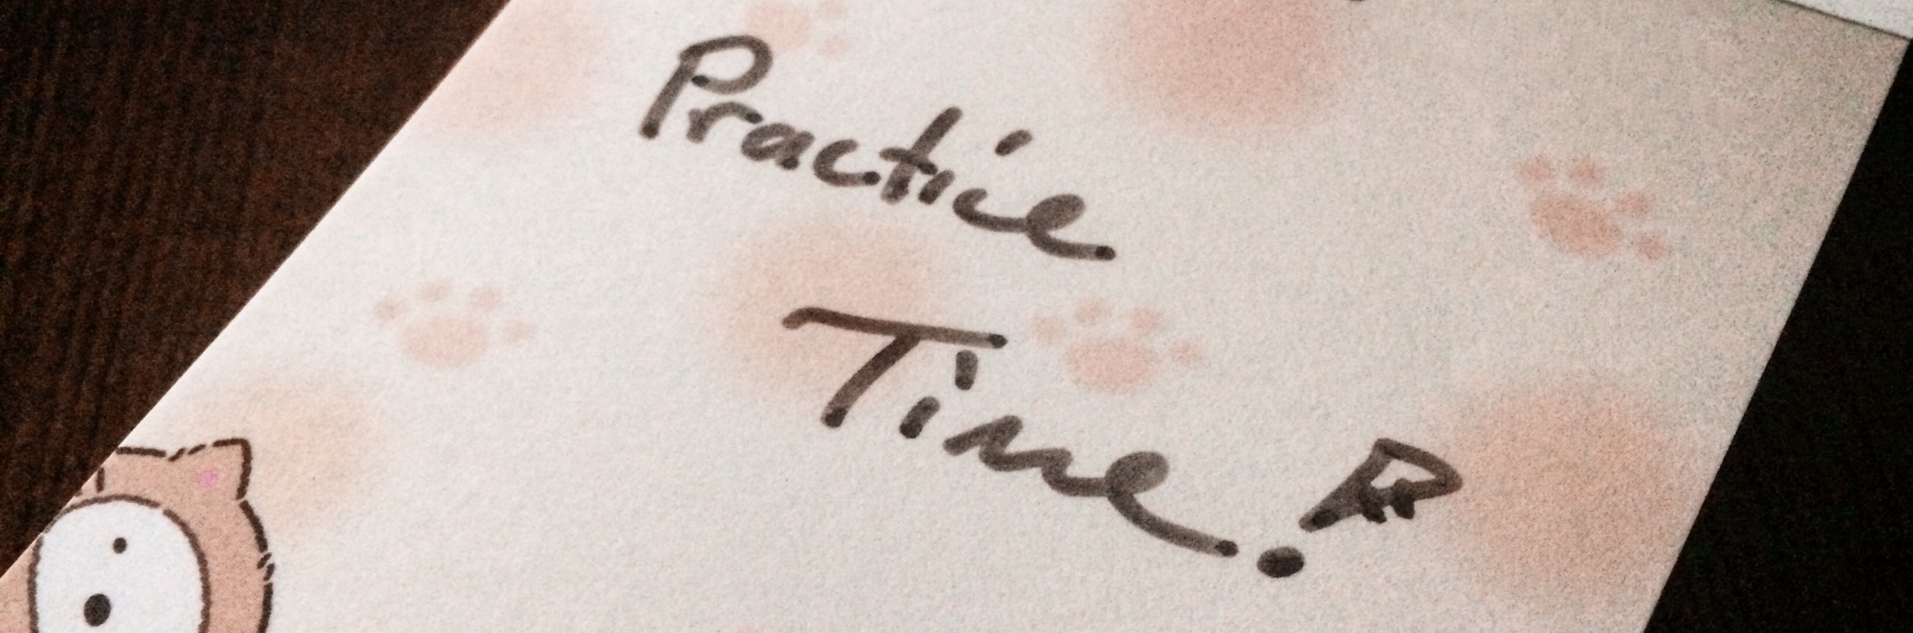
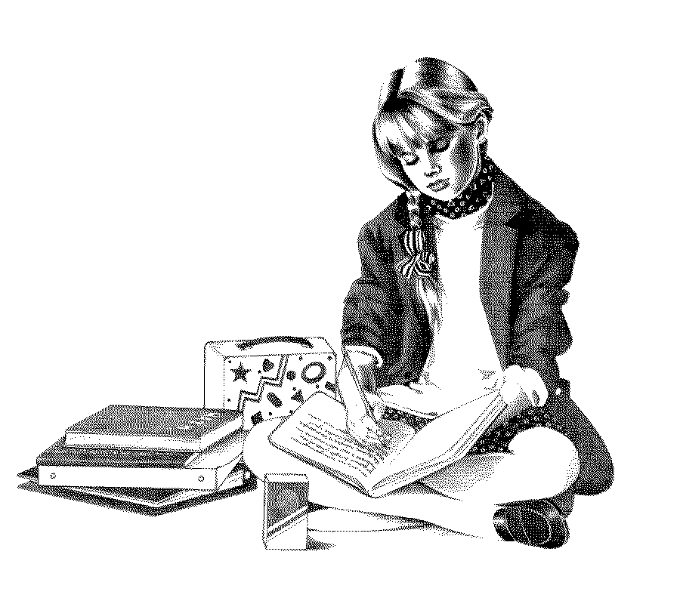
Let’s practise the grammar you have just learned, shall we?

Slide 32

Write question tags.
1- You are in the park, ------------------------------------------------------?
2- The movie was exciting, -------------------------------------------------?
3- The father isn’t reading a book, --------------------------------?
aren’t you
wasn’t it
is he

Slide 33
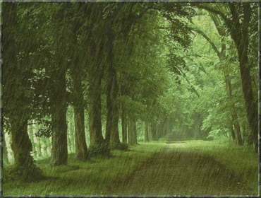
It was raining last night , ------------------------------------?
wasn’t it

Slide 34

Malaysia is a beautiful country, --------------------------------------?
isn’t it
isn’t it

Slide 35
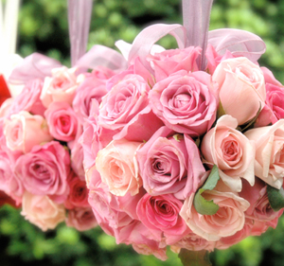
The flowers are wonderful, ------------------------------------------?
aren’t they

Slide 36
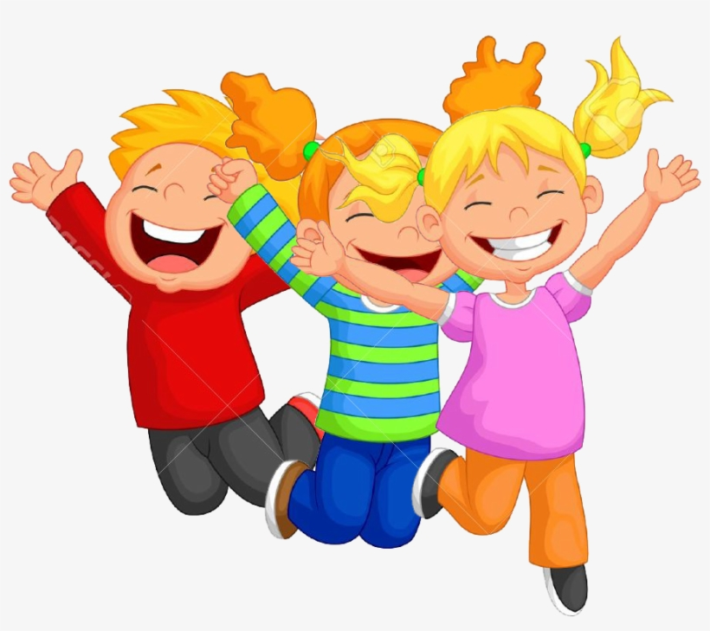
They were very happy, -----------------------------------------------------?
weren’t they

Slide 37
